Slide 1
Unit -5
HCI - DESIGN RULES , GUIDELINES AND
EVALUATION TECHNIQUES

Slide 2
Syllabus
Principles that support usability,
Design standards, Design Guidelines,
Golden rules and heuristics, Using toolkits,
User interface management system (UIMS),
Goals of evaluation, Evaluation Criteria, Evaluation through expert analysis,
Evaluation through user participation, Choosing an Evaluation Method.

Slide 3
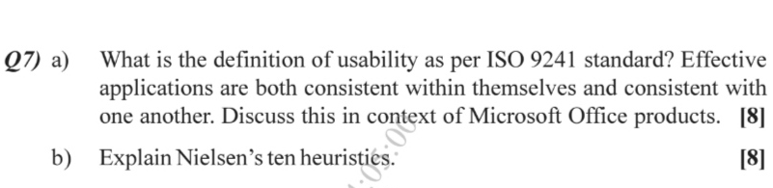
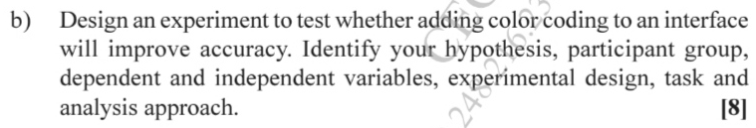
Frequently Asked Question in ENDSEM Exam

Slide 4
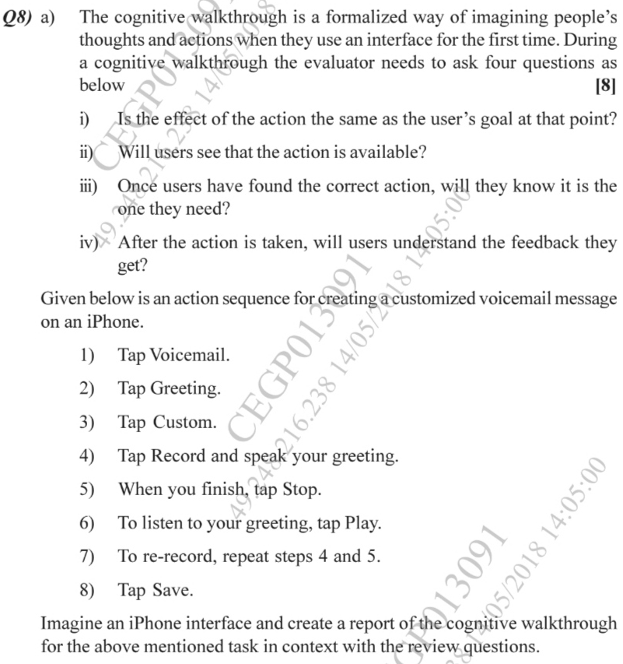

Slide 5
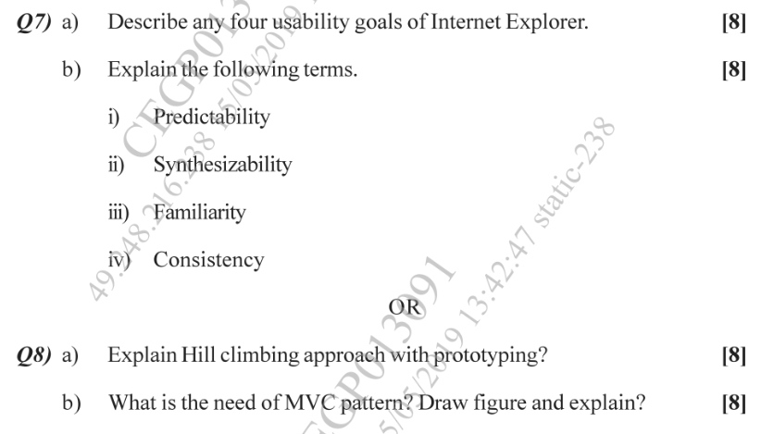

Slide 6
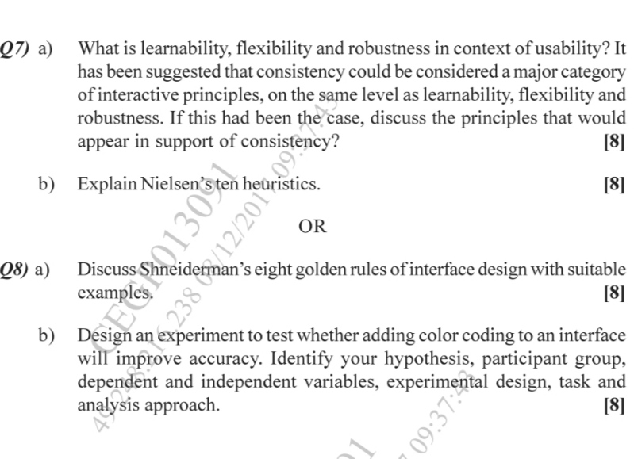

Slide 7



chapter 7
design rules

Slide 8
design rules
Designing for maximum usability
– the goal of interaction design
Principles of usability
  general understanding
Standards and guidelines
  direction for design
Design patterns
  capture and reuse design knowledge

Slide 9
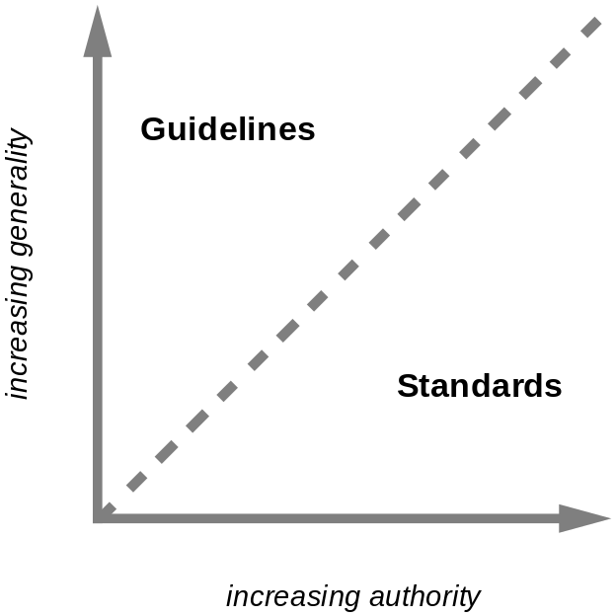
types of design rules
principles
  abstract design rules
  low authority
  high generality
standards
  specific design rules
  high authority
  limited application
guidelines
  lower authority
  more general application
increasing generality
increasing authority

Slide 10
Principles to support usability
Learnability
  the ease with which new users can begin effective interaction and achieve maximal performance
Flexibility
  the multiplicity of ways the user and system exchange information
Robustness
  the level of support provided the user in determining successful achievement and assessment of goal-directed behaviour

Slide 11
Principles of learnability
Predictability
  determining effect of future actions based on past interaction history
  operation visibility, refers to how the user is shown the availability of operations that can be performed next
  E.g. Video Game, Math Puzzle
Synthesizability
  assessing the effect of past actions on current state
  immediate vs. eventual honesty
  E.g. File Copy operation using CLI and GUI

Slide 12
Principles of learnability (ctd)
Familiarity
  how prior knowledge applies to new system
  guessability; affordance
  Type Writer to Word Processor
Generalizability
  extending specific interaction knowledge to new situations
  E.g. a square can be drawn as a constrained rectangle
Consistency
  likeness in input/output behaviour arising from similar situations or task objectives

Slide 13
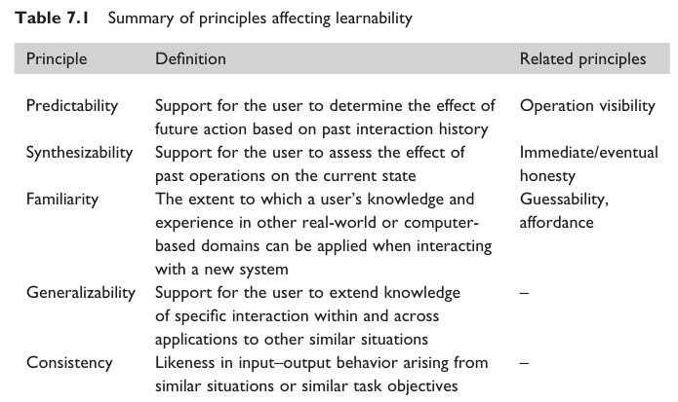
Principles of learnability (ctd)

Slide 14
Principles of flexibility
Dialogue initiative
  freedom from system imposed constraints on input dialogue
  system vs. user pre-emptiveness
Multithreading
  ability of system to support user interaction for more than one task at a time
  concurrent vs. interleaving; multimodality
Task migratability
  passing responsibility for task execution between user and system
  E.g. Spell Check in word processor

Slide 15
Principles of flexibility (ctd)
Substitutivity
  allowing equivalent values of input and output to be substituted for each other
  representation multiplicity; equal opportunity
  E.g. Margin of page in Inches and CM
Customizability
  modifiability of the user interface by user (adaptability) or system (adaptivity)

Slide 16
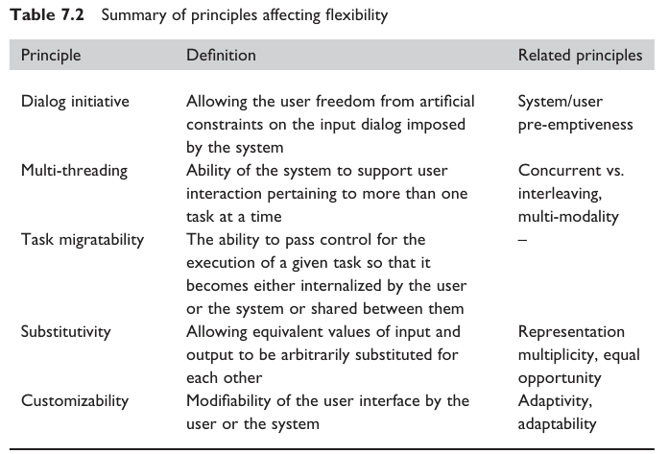
Principles of flexibility (ctd)

Slide 17
Principles of robustness
Observability
  ability of user to evaluate the internal state of the system from its perceivable representation at interface
  Five Principals:browsability; defaults; reachability; persistence; operation visibility
Recoverability
  ability of user to take corrective action once an error has been recognized
  reachability; forward/backward recovery; commensurate effort

Slide 18
Principles of robustness (ctd)
Responsiveness
  how the user perceives the rate of communication with the system
  Stability
Task conformance
  degree to which system services support all of the user's tasks
  task completeness: Addresses coverage issues
  task adequacy: Addresses the users understanding of task

Slide 19
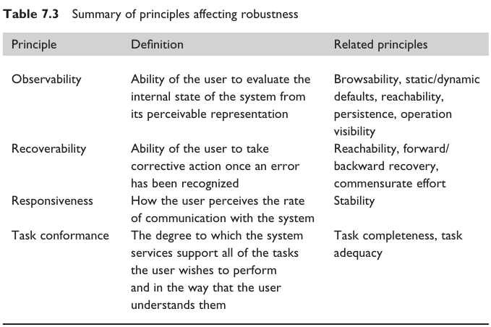
Principles of robustness (ctd)

Slide 20
Using design rules
Design rules
suggest how to increase usability
differ in generality and authority
increasing generality
increasing authority

Slide 21
Standards
set by national or international bodies to ensure compliance by a large community of designers standards require sound underlying theory and slowly changing technology
hardware standards more common than software high authority and low level of detail
ISO 9241 defines usability as effectiveness, efficiency and satisfaction with which users accomplish tasks

Slide 22
Standards
UK Ministry of Defence has published an Interim Defence Standard 00–25 on Human Factors for Designers of Equipment, produced in 12 parts:
Part 1: Introduction
Part 2: Body Size
Part 3: Body Strength and Stamina
Part 4: Workplace Design
Part 5: Stresses and Hazards
Part 6: Vision and Lighting
Part 7: Visual Displays
Part 8: Auditory Information
Part 9: Voice Communication
Part 10: Controls
Part 11: Design for Maintainability
Part 12: Systems

Slide 23
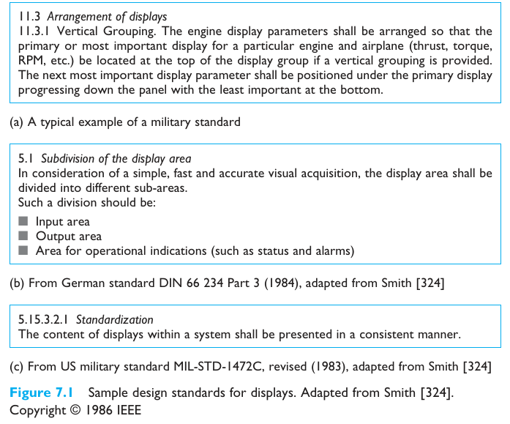

Slide 24
Guidelines
more suggestive and general
many textbooks and reports full of guidelines
abstract guidelines (principles) applicable during early life cycle activities
detailed guidelines (style guides) applicable during later life cycle activities
understanding justification for guidelines aids in resolving conflicts

Slide 25
Guidelines
Basic Categories of Smith & Mosier guidelines:
  1. Data Entry
  2. Data Display
  3. Sequence Control
  4. User Guidance
  5. Data Transmission
  6. Data Protection

Slide 26
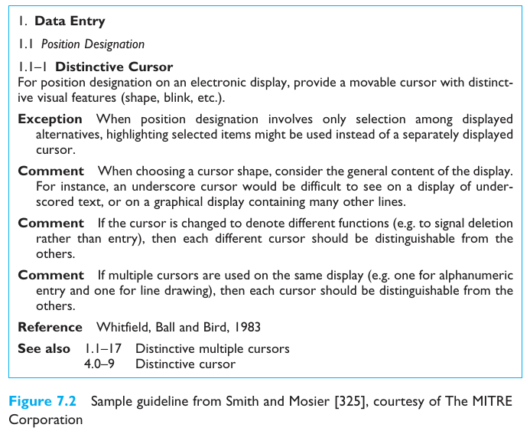

Slide 27
Golden rules and heuristics
“Broad brush” design rules
Useful check list for good design
Better design using these than using nothing!
Different collections e.g.
  Nielsen’s 10 Heuristics (see Chapter 9)
  Shneiderman’s 8 Golden Rules
  Norman’s 7 Principles

Slide 28
Shneiderman’s 8 Golden Rules
1. Strive for consistency
2. Enable frequent users to use shortcuts
3. Offer informative feedback
4. Design dialogs to yield closure
5. Offer error prevention and simple error handling
6. Permit easy reversal of actions
7. Support internal locus of control
8. Reduce short-term memory load

Slide 29
Norman’s 7 Principles
1. Use both knowledge in the world and knowledge in the head.
2. Simplify the structure of tasks.
3. Make things visible: bridge the gulfs of Execution and Evaluation.
4. Get the mappings right.
5. Exploit the power of constraints, both natural and artificial.
6. Design for error.
7. When all else fails, standardize.

Slide 30
HCI design patterns
An approach to reusing knowledge about successful design solutions
Originated in architecture: Alexander
A pattern is an invariant solution to a recurrent problem within a specific context.
Examples
  Light on Two Sides of Every Room (architecture)
  Go back to a safe place (HCI)
Patterns do not exist in isolation but are linked to other patterns in languages which enable complete designs to be generated

Slide 31
HCI design patterns (cont.)
Characteristics of patterns
  capture design practice not theory
  capture the essential common properties of good examples of design
  represent design knowledge at varying levels: social, organisational, conceptual, detailed
  embody values and can express what is humane in interface design
  are intuitive and readable and can therefore be used for communication between all stakeholders
  a pattern language should be generative and assist in the development of complete designs.

Slide 32
Summary
Principles for usability
  repeatable design for usability relies on maximizing benefit of one good design by abstracting out the general properties which can direct purposeful design
  The success of designing for usability requires both creative insight (new paradigms) and purposeful principled practice
Using design rules
  standards and guidelines to direct design activity

